Slide 1
Bed Bath & Yonder
Predicting customer spend
Manoj Sharma – Lead Data Scientist

Slide 2
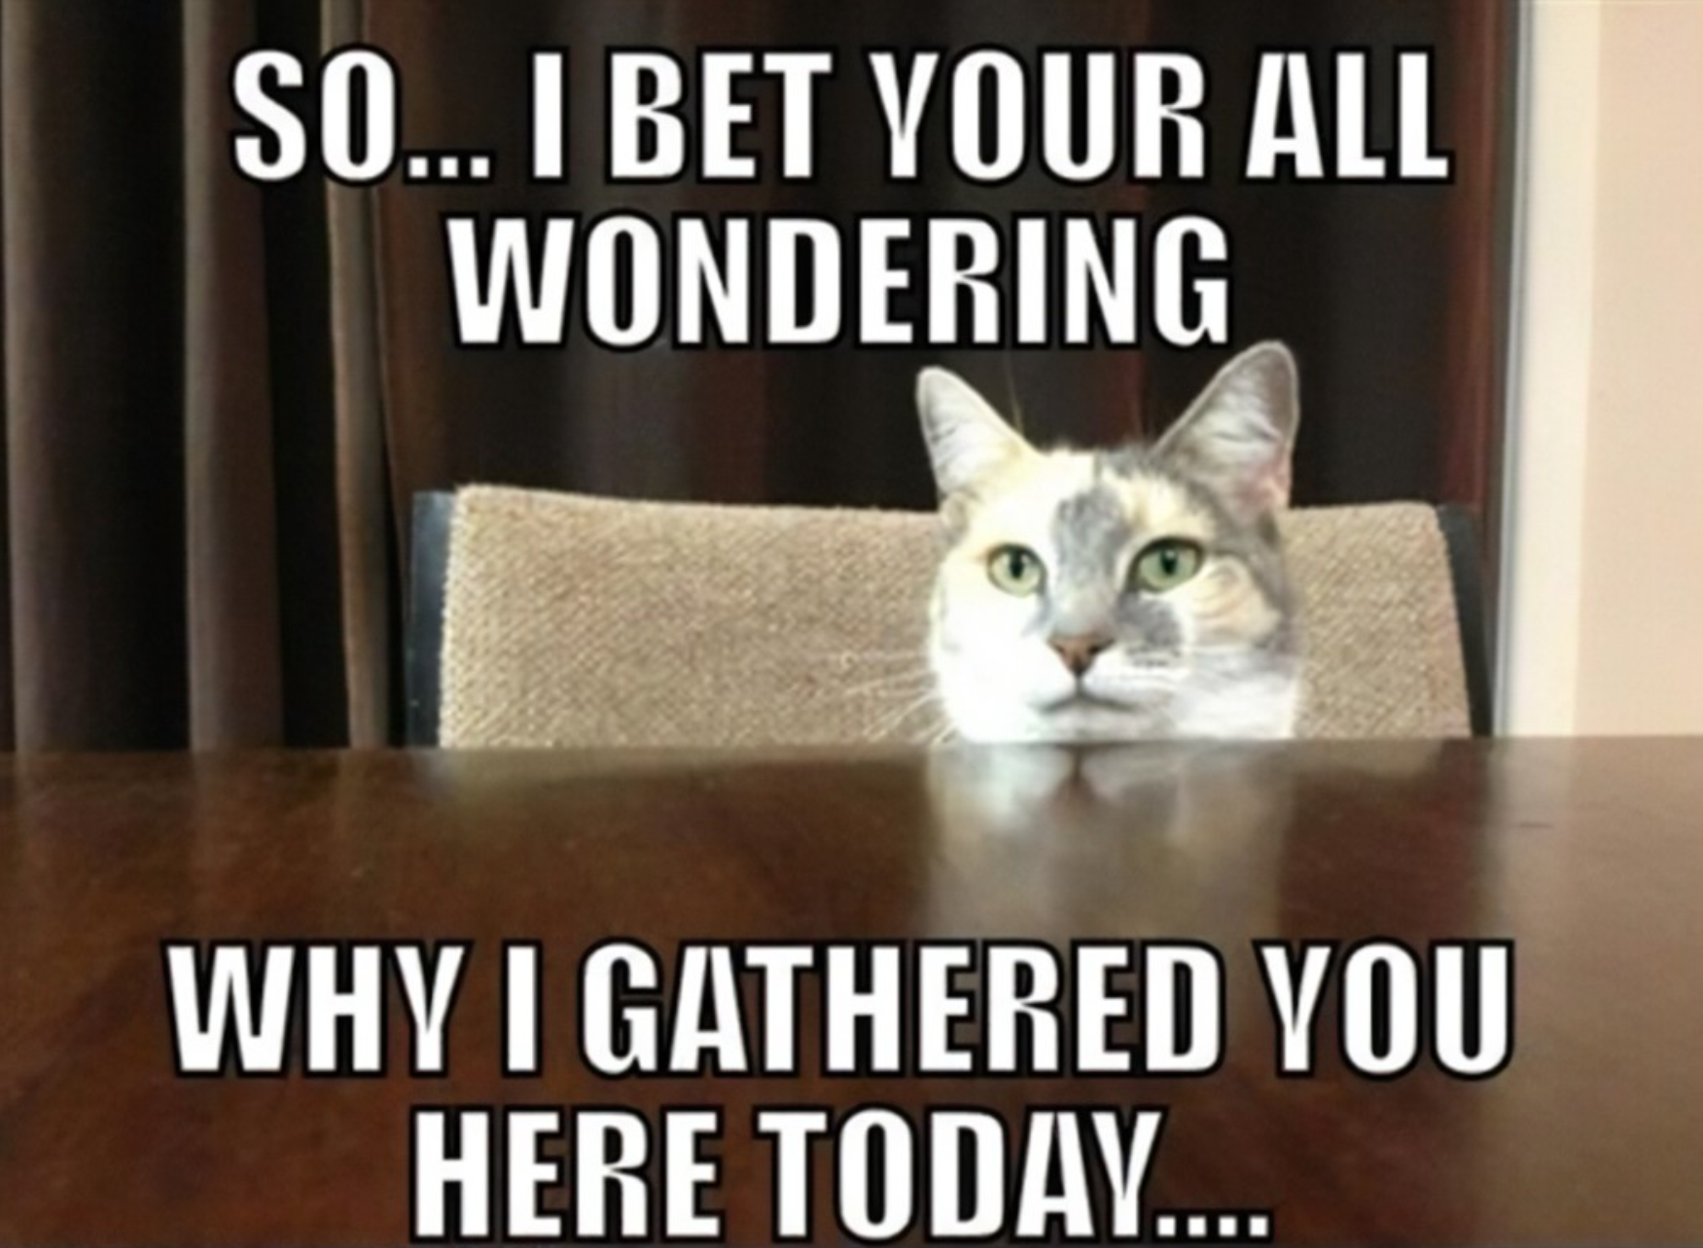
Agenda
Problem statement
Available data
Approach
Data insights
Modeling methods and results
Conclusion

Slide 3

Problem statement
Bed Bath and Yonder (BBY) intends to tailor promotions for Loyalty program customers based on their household spend.
Need to predict household spend based on customer data.
This Photo by Unknown Author is licensed under CC BY-SA

Slide 4

Available data

Slide 5
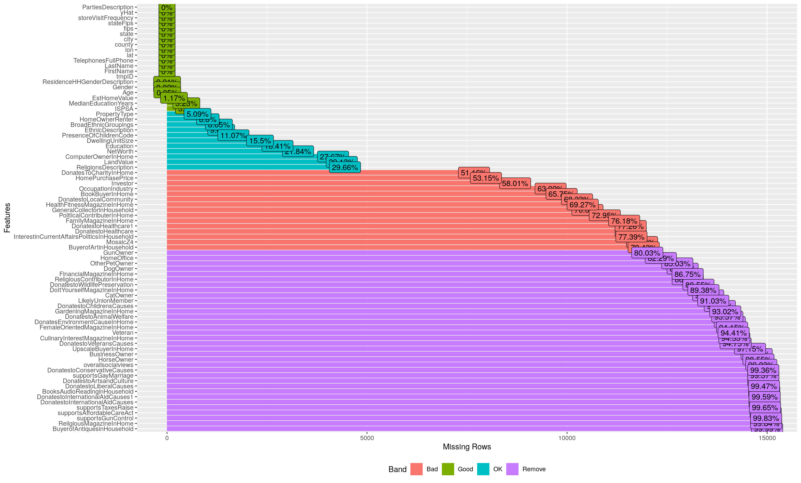
Available data
Blanks
Missing
‘Unknown’s

Slide 6
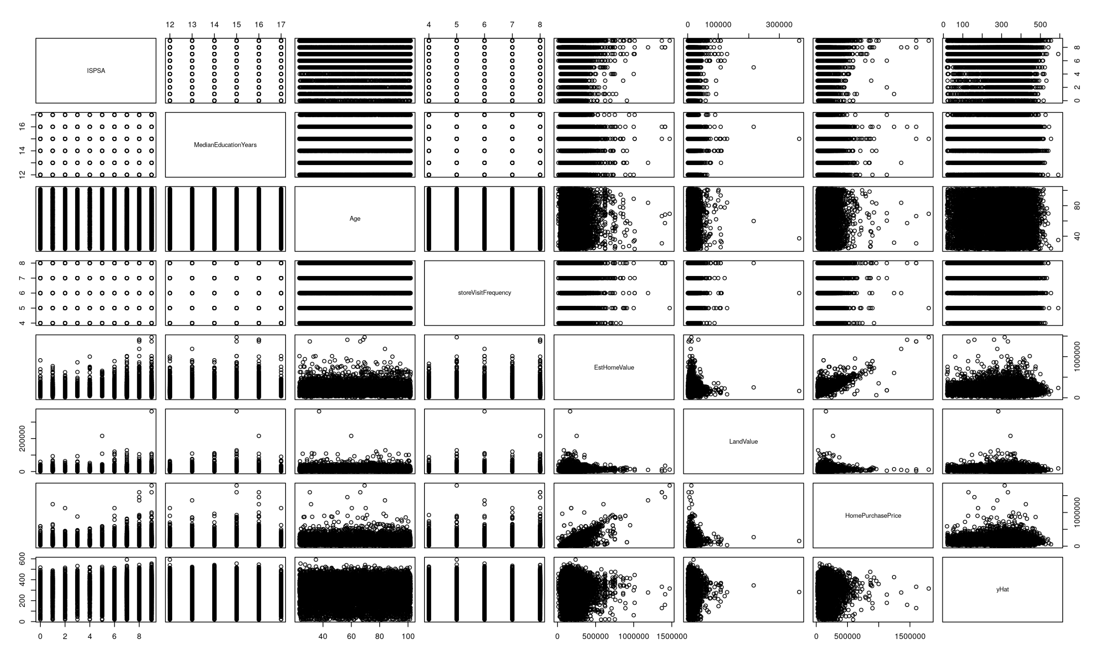
Data visualization
Many outliers
No clear correlation
Few numerical vars

Slide 7
Approach
SAMPLE
Review samples data
Plan options to clean and categorize data
EXPLORE
Explore data
Check distributions, correlations
MODIFY
Clean and modify data
Create features
MODEL
Model
Try different models
ASSESS
Analyze Results
Flexible
Iterative
Repeatable
Generalized

Slide 8
Feature modifications

Slide 9
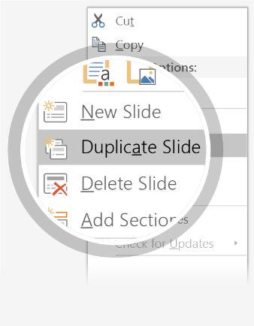
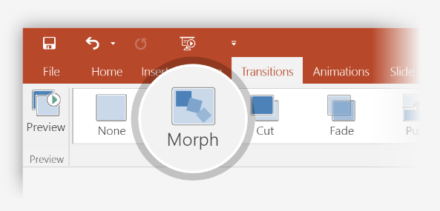
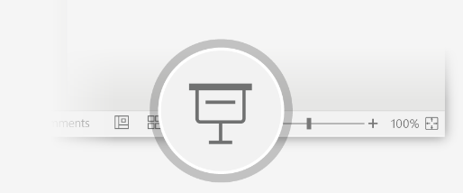
Setting up Morph
Try it yourself with these two simple “planets”:
1
Duplicate this slide: Right-click the slide thumbnail and select Duplicate Slide.
2
In the second of these two identical slides, change the shapes on the right in some way (move, resize, change color), then go to Transitions > Morph.
3
Return to the first of the two slides and press Slide Show button and then select Play to see your circle morph!
Hint: Effect Options gives you even more options for Morph.

Slide 10
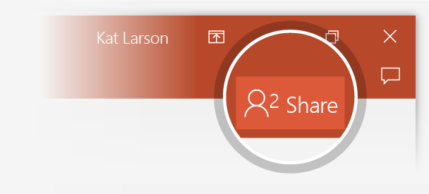
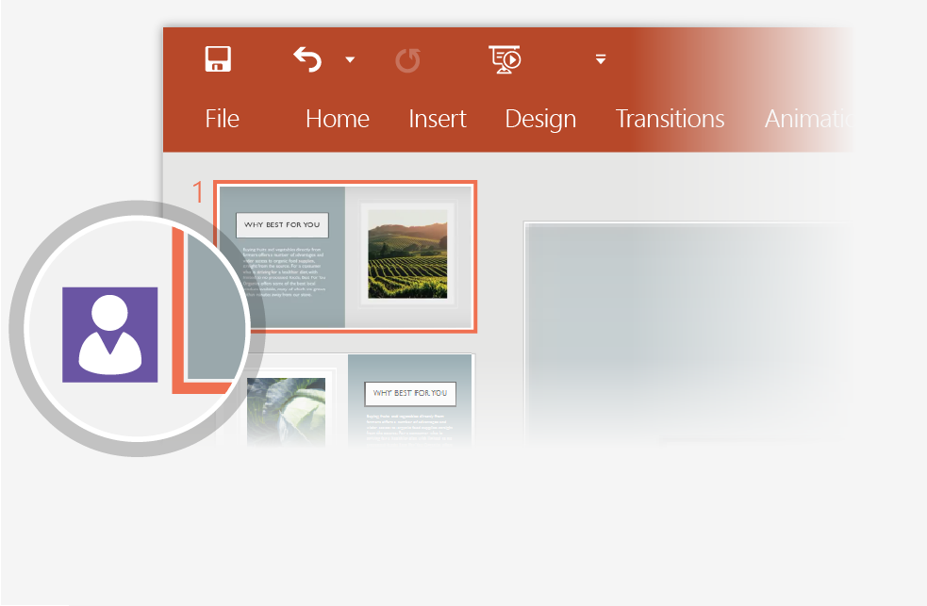
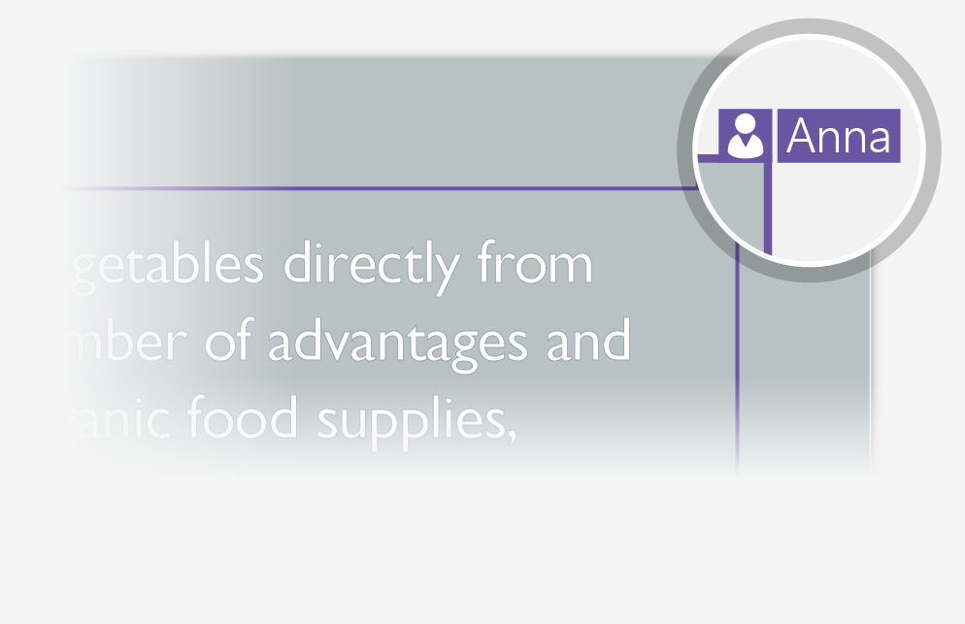
Working together in real time
When you share your presentation with others, you’ll see them working with you at the same time. How it works:
1
Select Share from above the ribbon, or by using short-key Alt-ZS, to invite people to work with you (You can save to the cloud at this point.)
2
When other people are in the presentation, a marker shows who is on which slide…
3
…and the part of the slide they're editing.

Slide 11


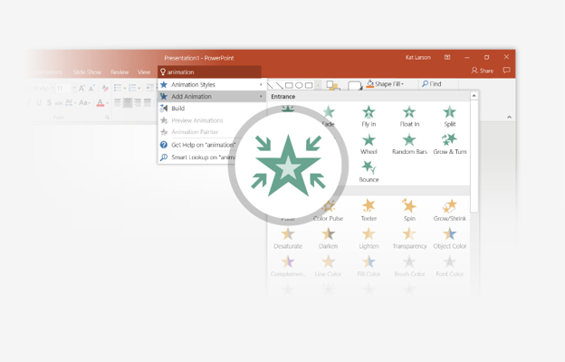
You’re an expert with Tell Me
The Tell Me box finds the right command when you need it, so you can save time and focus on your work. Try it:
SELECT ME
1
Select the Robot picture on the right.
2
Type animation in the Tell Me box, and then choose Add Animation.
3
Choose an animation effect, like Zoom, and watch what happens.

Slide 12
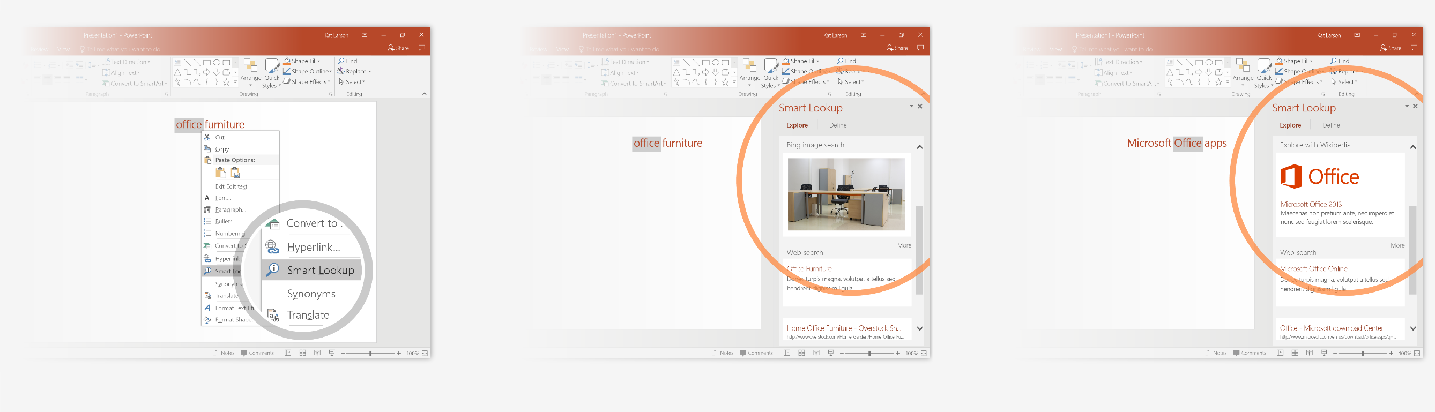
Explore without leaving your slides
Smart Lookup brings research directly in to PowerPoint. Try it:
1
Right-click in the word office in the following phrase: office furniture
2
Choose Smart Lookup, and notice that results are contextual for that phrase, not Microsoft Office apps.
3
Just for fun, try Smart Lookup again by right-clicking in the word Office in Step 2.

Slide 13

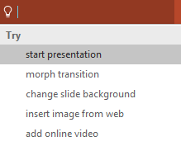

More questions about PowerPoint?
Select the Tell Me button and type what you want to know.
Visit the PowerPoint team blog
Go to free PowerPoint training
SELECT THE ARROW WHEN IN SLIDE SHOW MODE

